Slide 1
Extraction of the motion of fingers

Slide 2
Goal:
To extract the motion of fingers (in their three articulations) of keyboard player from a video sequence

Slide 3
Relevance of the problem
Computation of the keystroke efficiency and individual joint contributions
Directly related to the precision in timing and force measures

Slide 4
Starting point :
Two videos are taken from two different perspectives of a pianist playing the piano.
The videos were taken from above and from the side and in both recordings the hands of the pianist were captured.

Slide 5
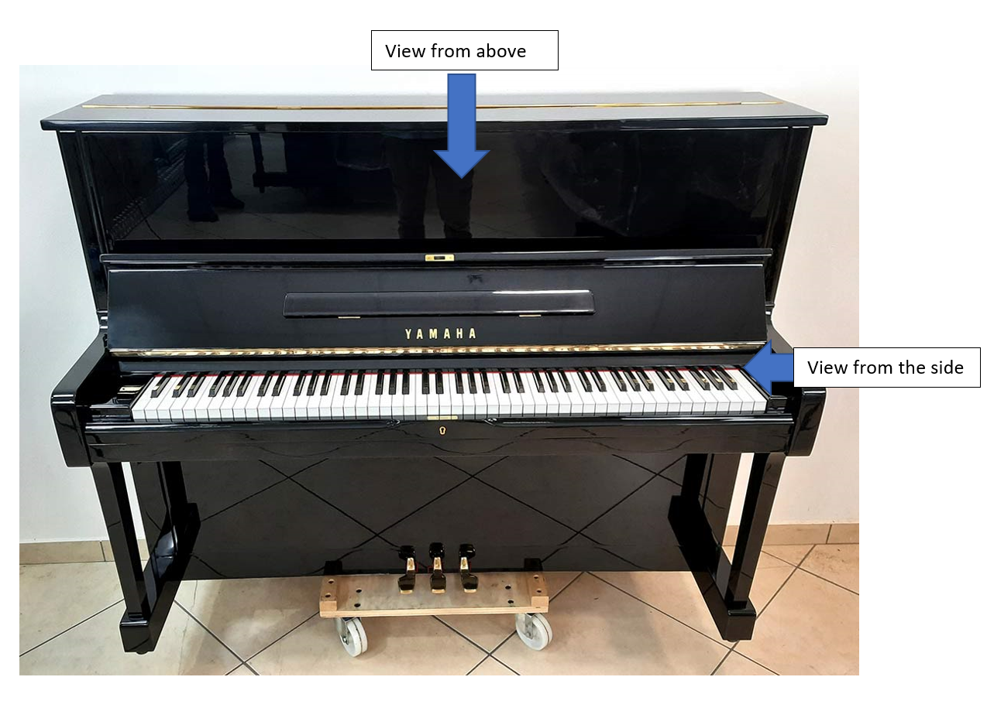

Slide 6
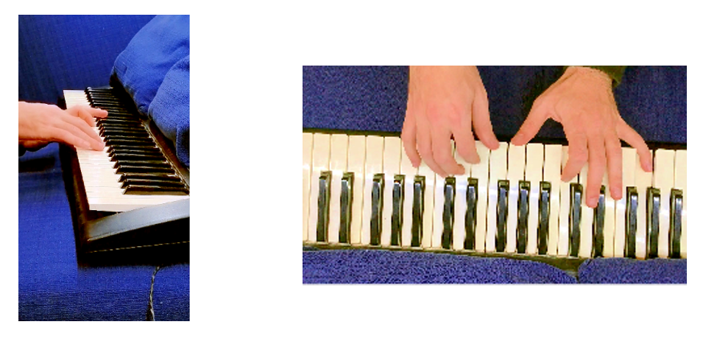
Apply a dehaze filter to obtain a good exposition

Slide 7
Create an RGB filer to filter the hands
imgGray=B(:,:,1)>90 & B(:,:,1)<180 & B(:,:,2)>40 & B(:,:,2)<65 & B(:,:,3)>10 & B(:,:,3)<55;

Slide 8
Input of the RGB filter

Slide 9
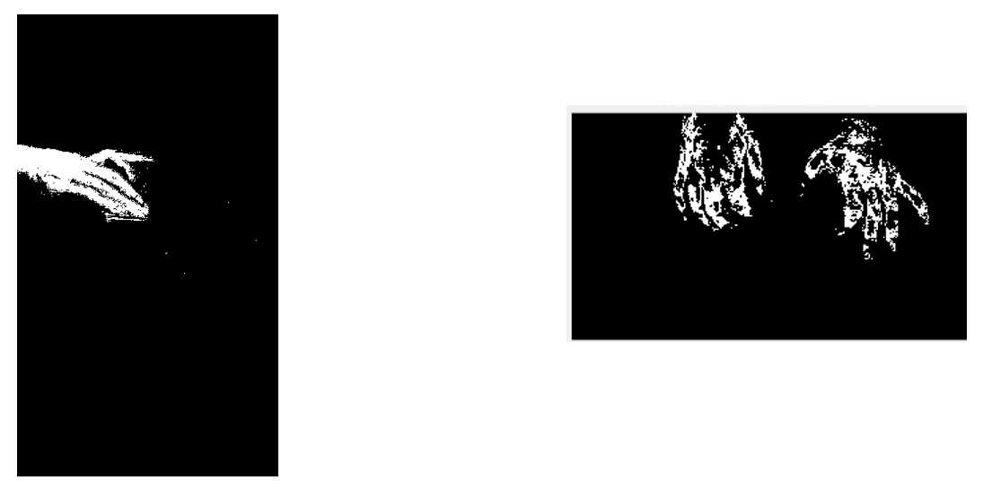

Output of the RGB filter
Upper view:
I created two images: one for each hand and I sized them

Slide 10
Upper view

Slide 11
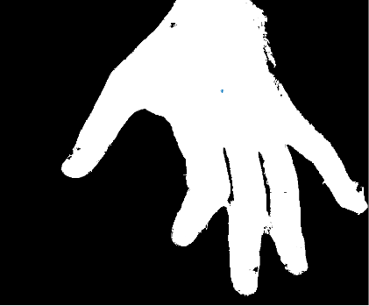
Compute the centre of the palm
Resize the images to try to centre the palm of the hands and extract the edges using the Canny method
Compute the distance transform of the obtained image of each hand and find the point of the image having the maximum value

Slide 12
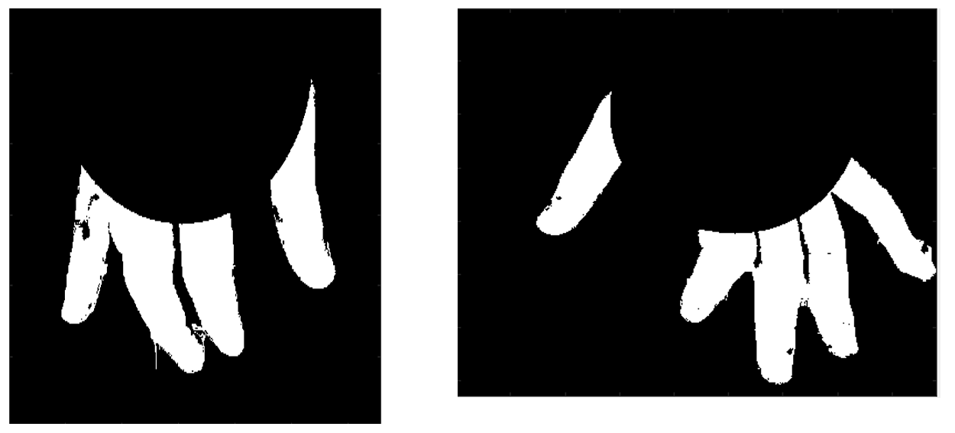
Extract the fingers
Remove a circle centred in the previously computed centre of the palm from the image of the hands

Slide 13
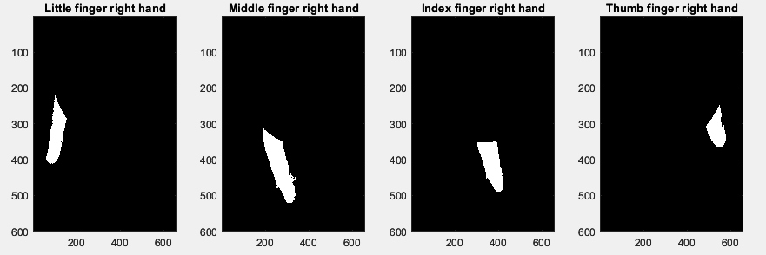
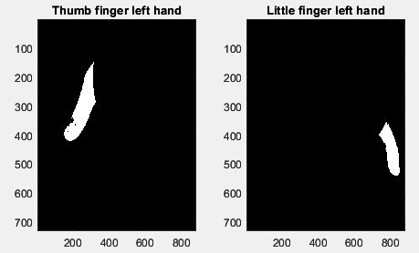
Compute the connected components

Slide 14
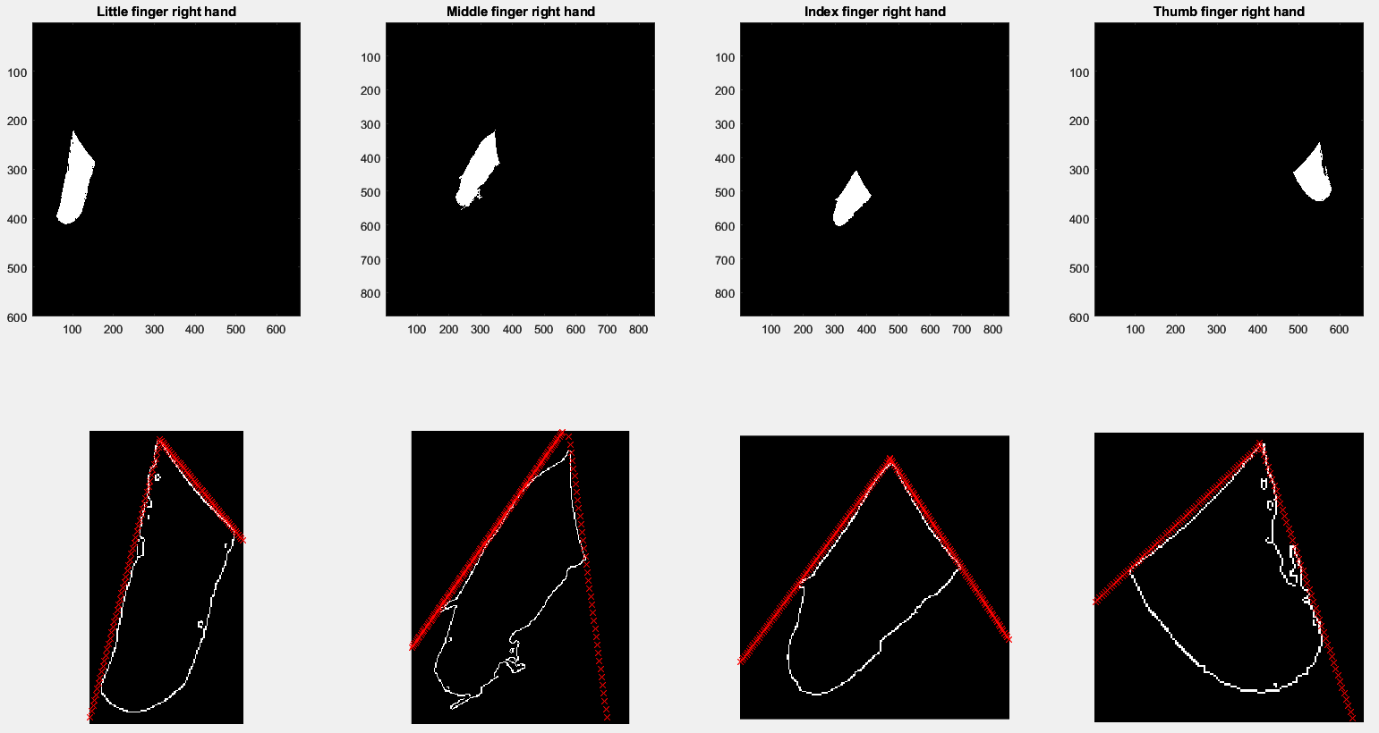
Crop and possibly rotate
Compute some tangency lines to make the identification of the junctions easier

Slide 15
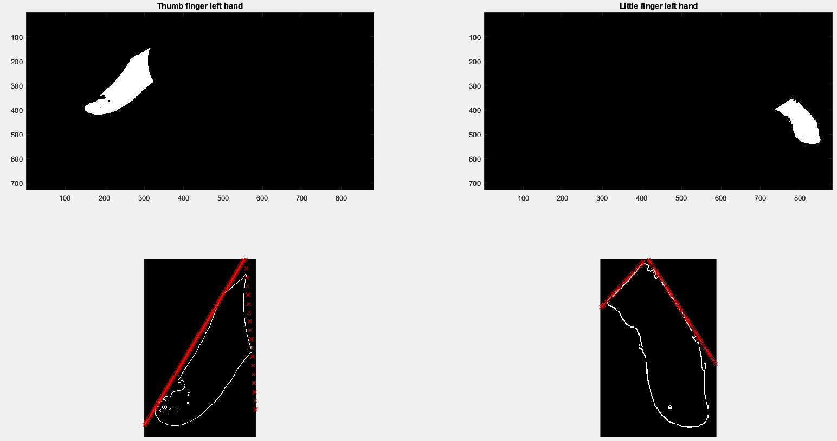

Slide 16
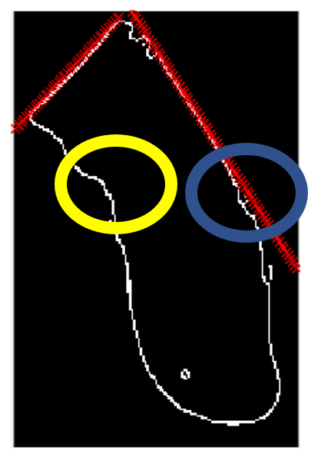
It is quite easy to identify the three articulations because the edges move far away from the line as soon as a junction is met and also by observing the change of the inclination of the edges of the profile of the lower part of the finger.

Slide 17
The point from which the edges of the finger begin to differ from the line (that in this case is the area inside the blue circle) identifies the last of the joints of the little finger (the one closest to the fingertip).

Slide 18
The same joint can also be identified by observing the change of the inclination of the edges of the profile of the lower part of the finger (that in this case is the area inside the yellow circle).

Slide 19
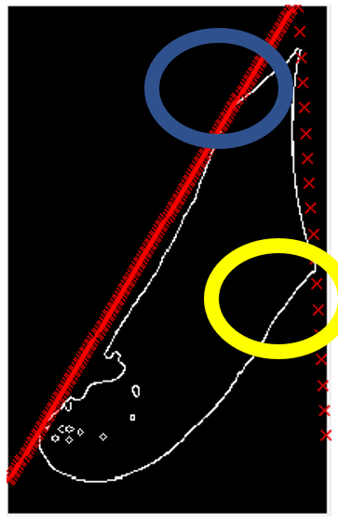

Slide 20
Side view

Slide 21
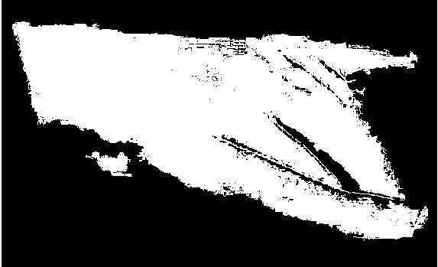

Slide 22
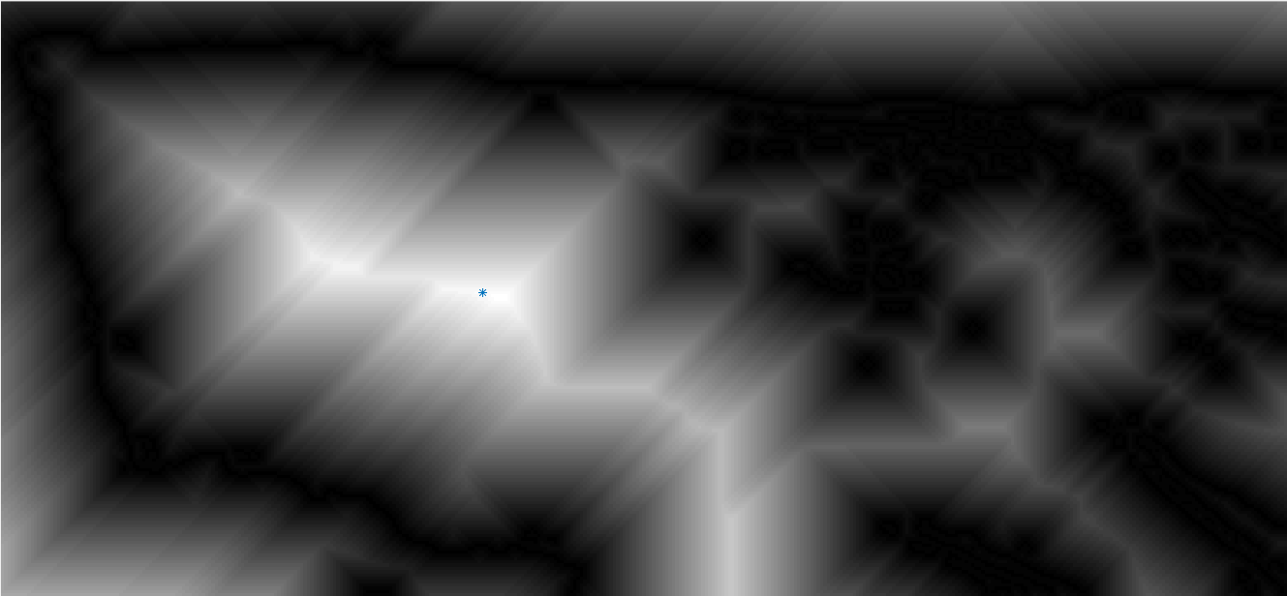
Compute the point closest to the centre of the hands
Compute the distance transform and find the point of the image having the maximum value

Slide 23
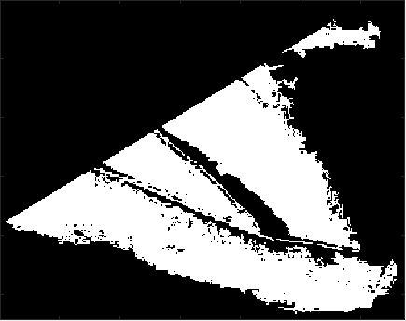
Extract the fingers
Remove a rectangle rotated by an appropriate angle centred in the previously computed point from the image of the hands

Slide 24
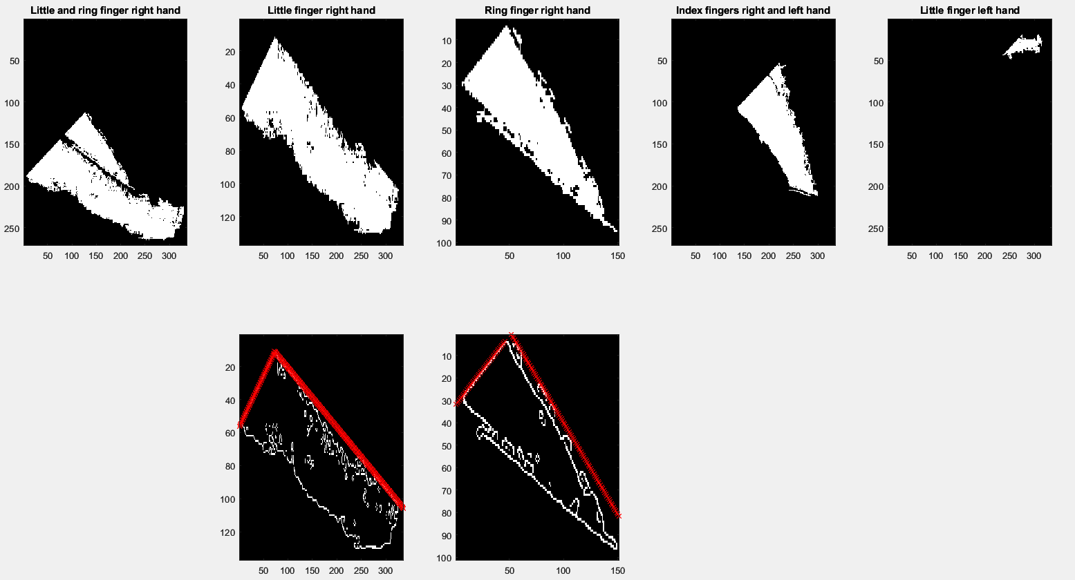

Slide 25
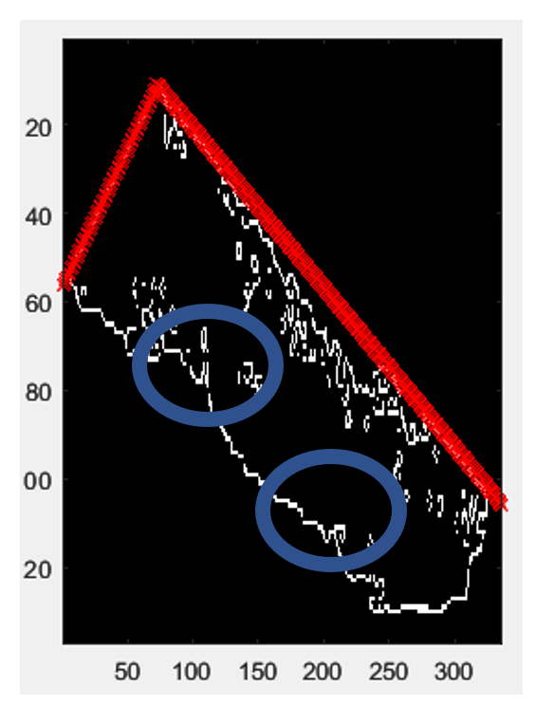
The two junctions can be easily detected by observing the change of the inclination in the edges of the profile of the lower part of the finger.
In this case, the junctions are contained in the blue circles.

Slide 26
Sources of error (upper view)
Little imprecisions in the computation of the centre of the palms due to the fact that the images of the hands had to be cropped (such that the palm was roughly centred) in order to eliminate the values of the distances of the borders.

Slide 27
Sources of error (upper view)
I adopted a fixed radius of the circle because this approach improved the precision of the detection of the correct radius, which otherwise would be probably underestimated due to the limited precision in the computation of the centre of the palm.

Slide 28
Sources of error (side view)
Some imprecisions in the computation of the point having the biggest distance transform value can be attributed to the noise that degraded the edges of the hands

Slide 29
Sources of error (side view)
The hands were too close to each other and made it impossible to discriminate between the left and right hand

Slide 30
Sources of error (side view)
The fact that I had to manually discriminate the little and ring finger of the right hand by creating an appropriate rectangle to be subtracted from the original image of the two fingers highlights the difficulty in distinguishing fingers that are close to each other and, as consequence, recognised as part of the same connected component.

Slide 31
Identification of the pressed keys

Slide 32
Goal:
To identify the pressed keys of a keyboard

Slide 33
Relevance of the problem
Useful to automatically evaluate the performance of a pianist or to automatically write sheet music of the melody that is being played

Slide 34
Starting point :
A video taken from the side of the piano and from above the keys level with an angulation of about 45 degrees wrt to the piano plane

Slide 35
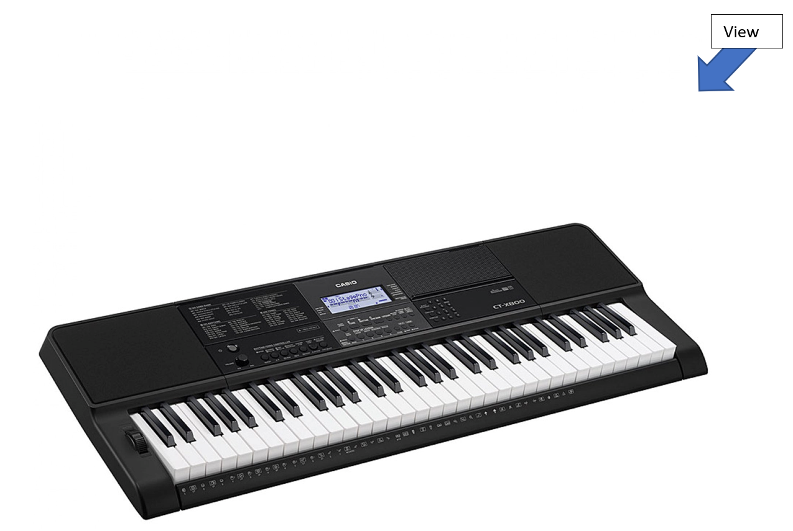

Slide 36
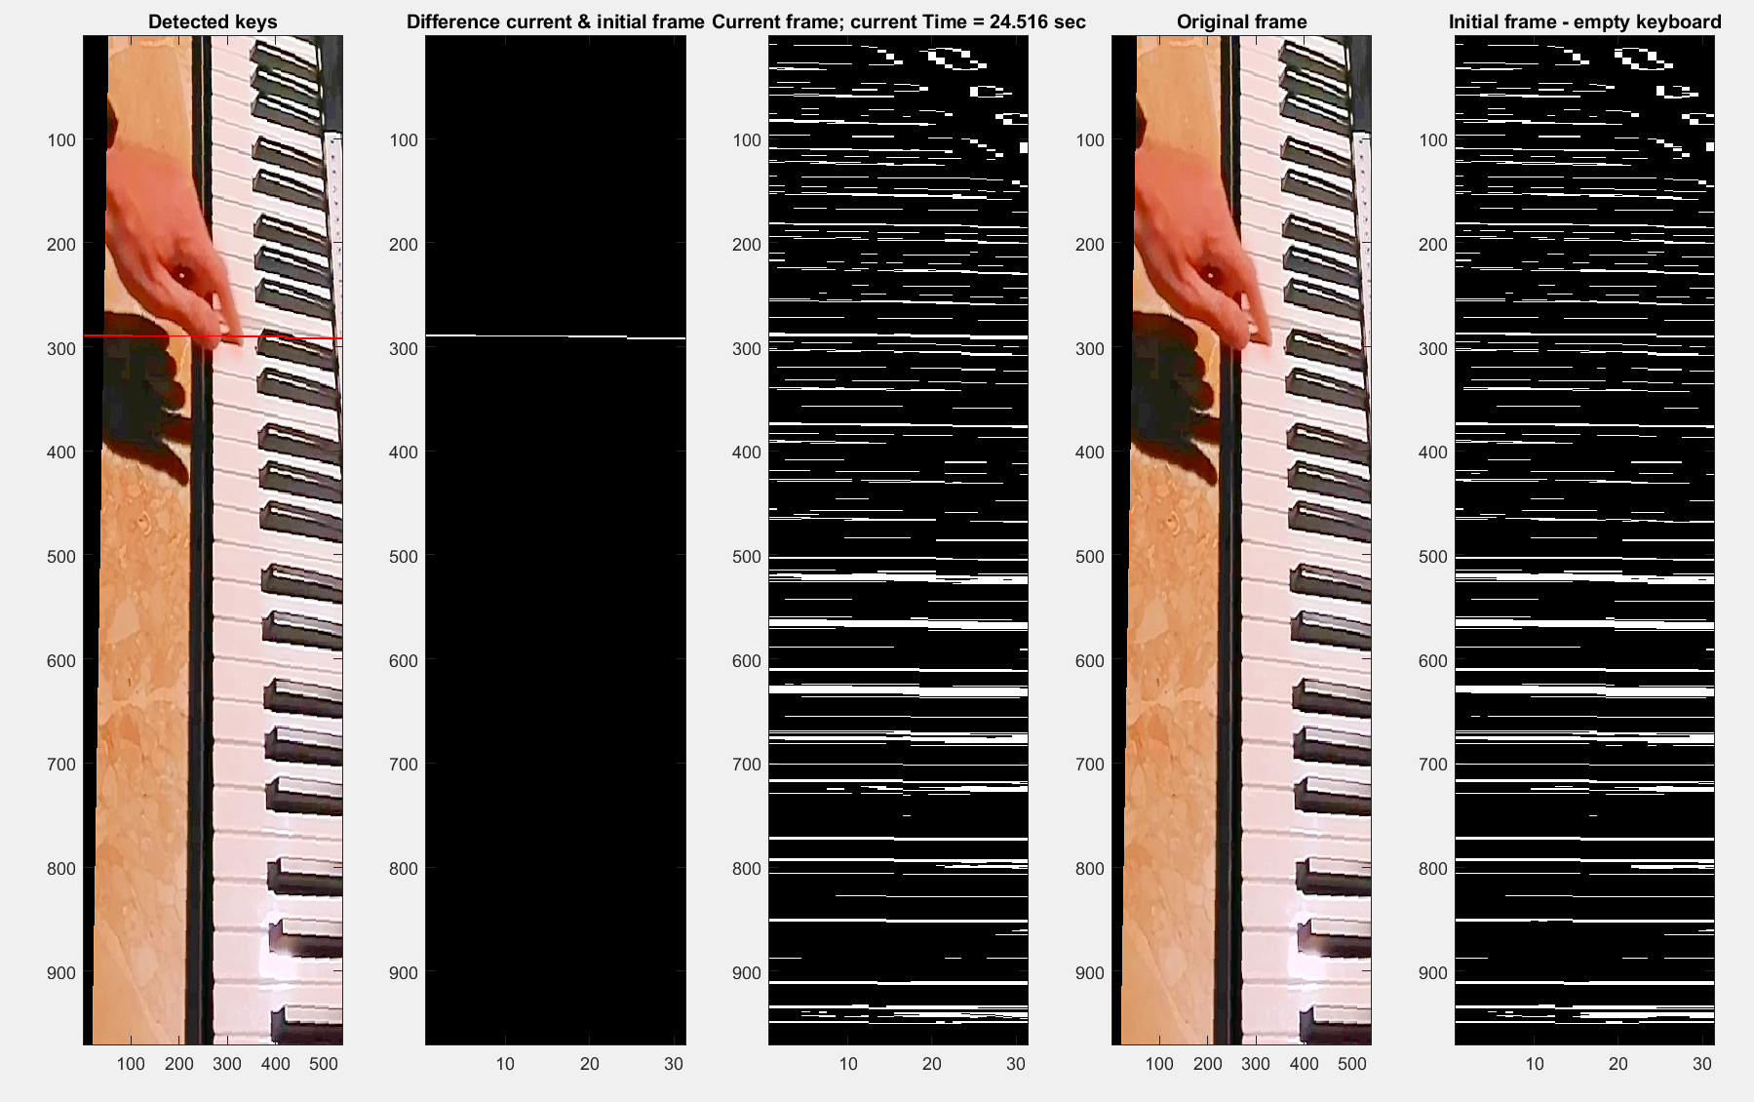
Rotate the frame and apply a dehaze filter

Slide 37
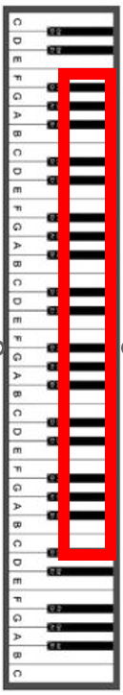
Apply an RGB filter to highlight the edges of the keys and crop the width to focus on the part of the keyboard that is bounded by the red rectangle.
Note that the hands of the pianist will not touch this part of the keyboard.

Slide 38
I noted that when a key is pressed, it is possible to observe a variation in the position of the pressed key in that area because of the position of the camera that is placed above the piano and its inclination wrt to the piano plane.

Slide 40
Save the last frame in which no keys are being pressed

Slide 41
Subtract that frame from the current frame
After removing the smallest connected components, only the line (lines) corresponding to the left side (sides) of the key ( keys) that is (are) currently pressed is (are) left.

Slide 42
After that, I created an RGB image starting from the raw current frame and setting to red the pixels corresponding to the pressed keys

Slide 43
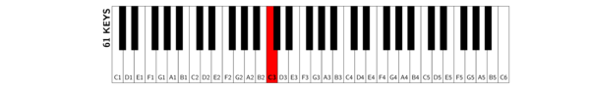
Identification of C3

Slide 44
As clearly shown, the pressed key is easy to detect because its left side is highlighted in red.
In this case, the pressed key is C3.

Slide 45
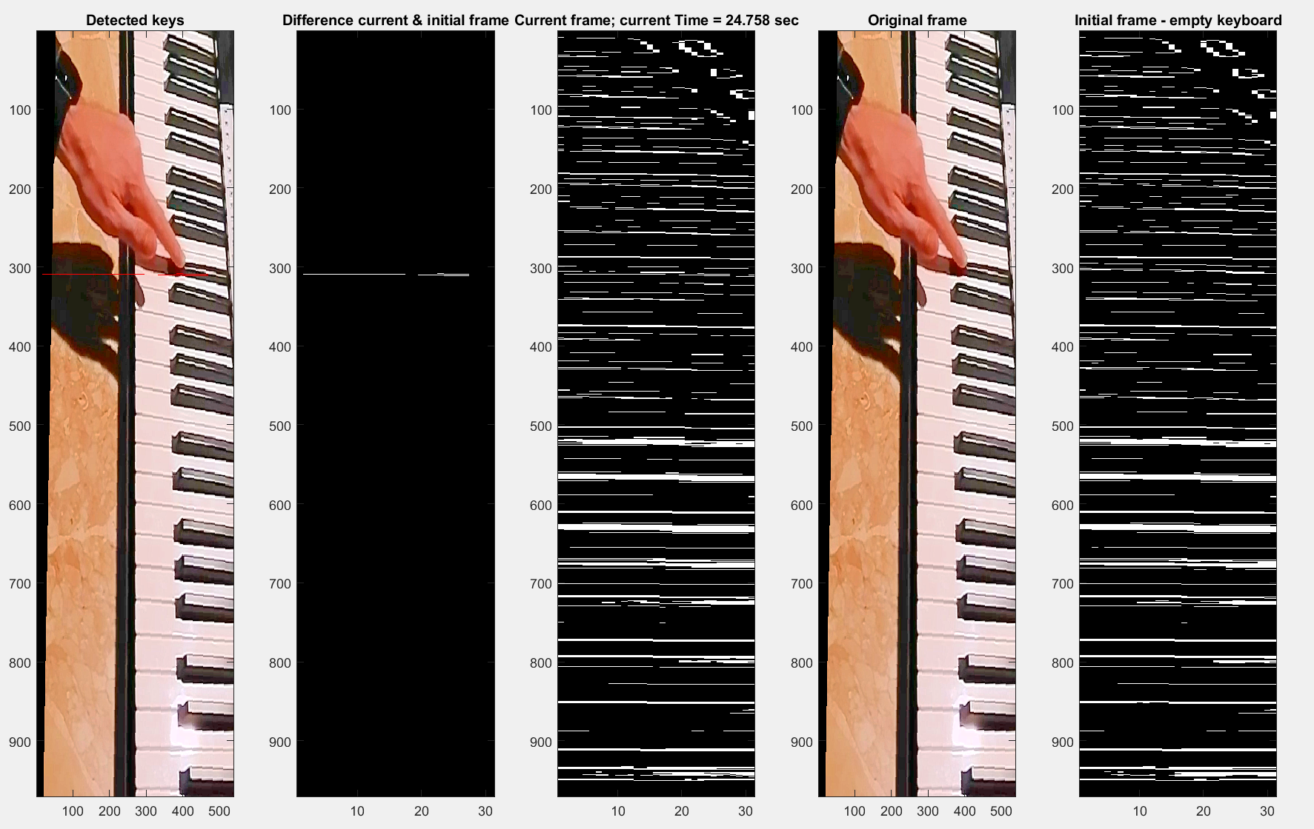
Identification of C3b (D3#)

Slide 46
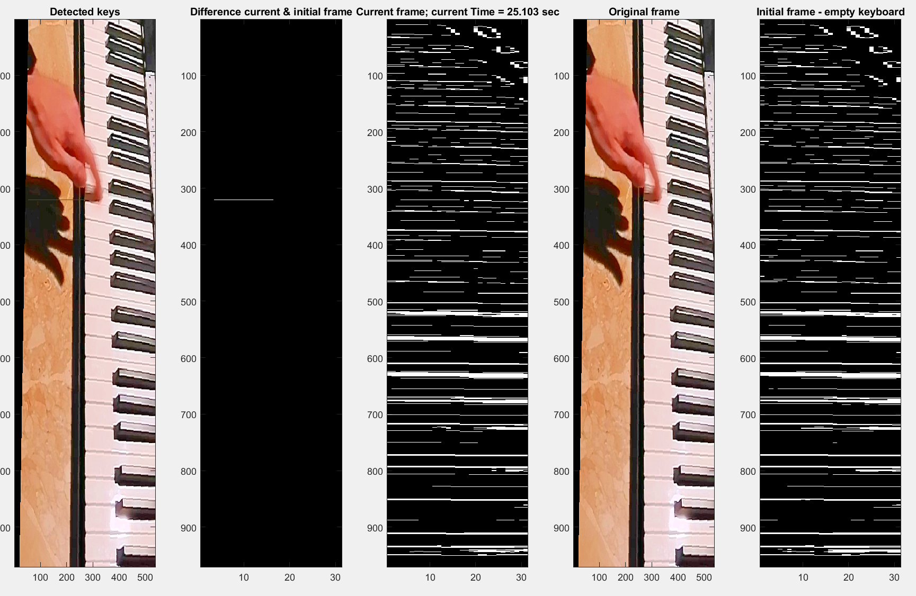
Identification of D3

Slide 47
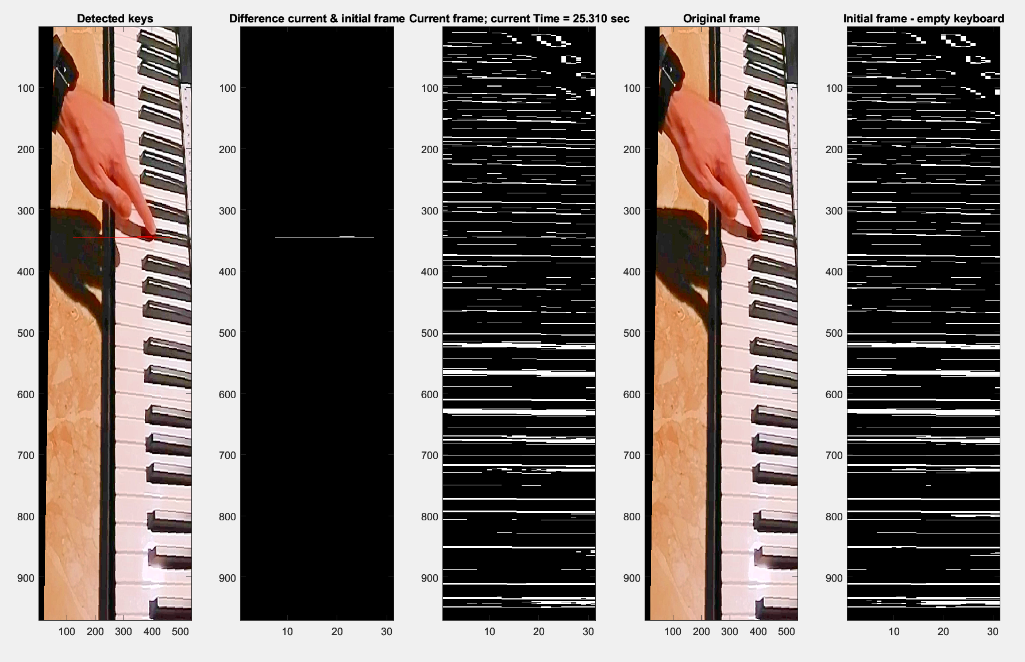
Identification of D3b(E3#)

Slide 48
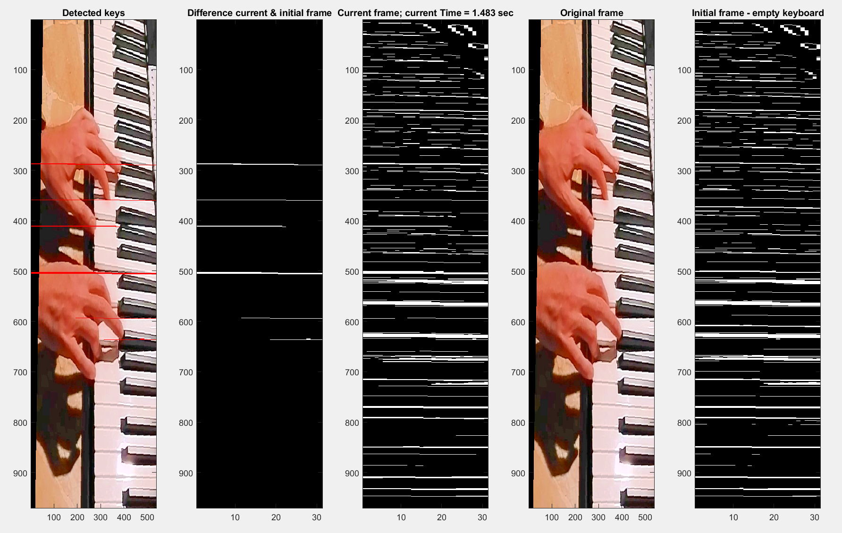
Identification of C3, E3, G3, C4, E4, G4

Slide 49
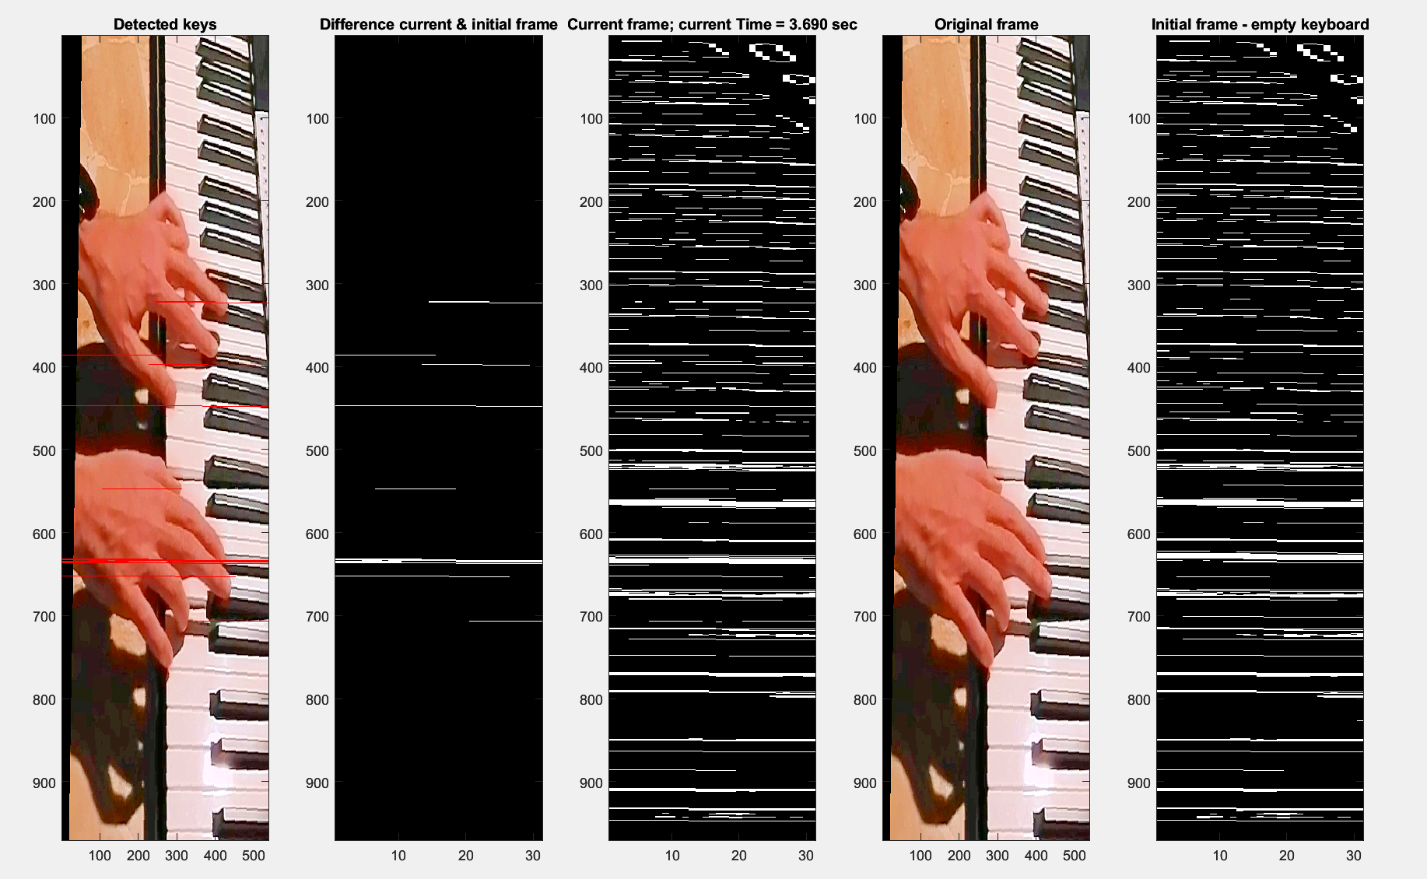
Identification of D3, F3b, A3, D4, F4b, A4

Slide 50
Identification of the keys
To identify the correct pressed keys I computed the top-left coordinates of each connected component that is in the difference frame and checked their value.
After having defined a suitable set of lower and upper bounds for the values of the coordinates for each key, I just checked for each frame whether the coordinates were part of one of the previously identified ranges that corresponded to a unique key.
if(285<=upperCoordinateTile & upperCoordinateTile<=295)
keyPressed= strcat(keyPressed, "C3; ");
end
if(305<=upperCoordinateTile & upperCoordinateTile<=315)
keyPressed= strcat(keyPressed, "C3b; ");
end
if(320<=upperCoordinateTile & upperCoordinateTile<=330)
keyPressed= strcat(keyPressed, "D3; ");
end
if(345<=upperCoordinateTile & upperCoordinateTile<=355)
keyPressed= strcat(keyPressed, "D3b; ");
end

Slide 51
1
2
The following is the log of the matlab program that runs the example that was shown previously (keys C3, C3b, D3, D3b are pressed in sequence ) in which the pressed keys are written together with the time
3
4

Slide 52
1
2
"Keys pressed: C3; at 24.413 sec“
"Keys pressed: C3; at 24.482 sec“
Keys pressed: C3; at 24.516 sec"
"Keys pressed: C3b; at 24.723 sec"
"Keys pressed: C3b; C3b; at 24.758 sec"
"Keys pressed: C3b; at 24.827 sec"
"Keys pressed: D3; at 25.103 sec"
"Keys pressed: D3b; at 25.275 sec"
3
4

Slide 53
The following is the log of the matlab program that runs the example that was shown previously (keys C3, E3, G3, C4, E4, G4 are pressed all at the same time ) in which the pressed keys are written together with the time.
"Keys pressed: E3; G3; C4; G4; E4; at 0.414 sec"
"Keys pressed: C4; E4; G4; at 0.448 sec"
"Keys pressed: C3; G3; C4; E3; E4; G4; at 0.483 sec"

Slide 54
Sources of error
It is crucial to create a suitable RGB filer to filter only the relevant part of the keyboard (almost no changes in the transformed frame should be detected when no keys is being pressed), otherwise, some false positives (incorrectly detected keys) may occur
It is also very important to carefully define the ranges, aiming to reach a very high accuracy: this is because, if ranges are not set properly, the repeated pression of the same key could be recognised as the pression of different keys.
Change of the light and micro vibrations caused by the pression of the keys can degrade the quality of the recognition, so those two factors should always be taken into account when producing the inputs
The choice of the threshold used to remove noisy connected components from the difference of the frames should be such that when no keys are pressed, the image should be black and that when one or more keys are pressed, the image should contain the connected components associated with the pressed keys only

Slide 55
Devices used in the experiment
Huawei P30 lite having a 48MP camera(f/1.8) Wide Angle lens, an 8MP Ultra-Wide Angle lens (f/2.4) and an 2MP dedicated bokeh lens
Huawei Mate 9 having a 8 MP camera, f/1.9, 26mm (wide), 1/3.2", 1.4µm, AF )
iPad having a 8MP camera, ƒ/2.4 aperture

Slide 56
In this work, I provided two approaches to solve two problems: the extraction of the motion of fingers (in their three articulations) of keyboard player and the identification of the pressed keys of a keyboard.

Slide 57
I proceeded by analysing many related works and trying to replicate some of the techniques used, analysing the experimental results of the application of those approaches in practice (many times it was necessary to repeat the experiments several times due to some external factors, as the lighting, that cannot be fully controlled easily) and changing them when the results were too poor.

Slide 58
I also used a mix of theoretical knowledge and intuition to find the cause of the problems that I faced during the process and to solve them.

Slide 59
The results obtained were satisfactory and it is quite easy to modify my approaches to run different examples or to implement more complex functions.

Slide 60
Thanks for your attention

